Slide 1
NeCTAR Training
Module 7
Launching and Connecting

Slide 2
Launching and Connecting
Instructions on how to set up your NeCTAR resources:
Launch a virtual machine and connect to it
via the command line
to a remote desktop
Setting up a web server & publish a website
Configure & access storage

Slide 3
General notes
What is an “Instance”?
In the NeCTAR Cloud, an instance is a virtual machine.
Instance vs. “Local computer”
Local computer is the physical computer you use to connect to your instance, using command line or a remote desktop client application.
Instance is the virtual machine running in the Cloud.

Slide 4
General notes
In this Module, we will follow the instructions given in the On-Line Documentation
Open your browser and go to the website:
<Paste URL to training docs>
While we do the exercises, you may follow the documentation to read detailed instructions.

Slide 5
General notes
In the slides, commands to type in a terminal are written according to the following scheme:
$ theCommand argument1 argument2 …
Each line starts with a $.
If the command goes over several lines, it does not mean that you have to hit [Enter] to type the command in several lines!

Slide 6
Preparation: Use of Terminals
On Windows, you will use two terminals:
The PuTTY terminal to connect to the instance. This Terminal will be referred to as the “ssh terminal”.
The Windows command line on your computer. This Terminal will be referred to as your “local Terminal”.
On Mac and Linux, there are built-in terminals:
Mac: search “Terminal” in the Spotlight Search.
Linux: search “Terminal” or Right-click on Desktop.
Notes:
On Windows, you will use two terminals:
The PuTTY terminal to connect to the instance. Download “Putty.exe” and “PuttyGen.exe” from the official website (google “PuTTY”). This Terminal will be referred to as the “ssh terminal”.
The Windows command line on your computer. Open it by typing “cmd” into the search field (on Windows < 8 on “Start”; on Windows 8 in the “App search” field). This Terminal will be referred to as your “local Terminal”.
On Mac and Linux, there are built-in terminals:
Mac: search “Terminal” in the Spotlight Search.
Linux: search “Terminal” or Right-click on Desktop.

Slide 7
Creating a SSH Key

Slide 8
Creating a SSH key
Before we create our first instance, we will need to generate a ssh key pair for connecting to our instances.
An ssh key pair is required to encrypt the data traveling between you and the instance.
The pair consists of two keys: A private key, and a public key.

Slide 9
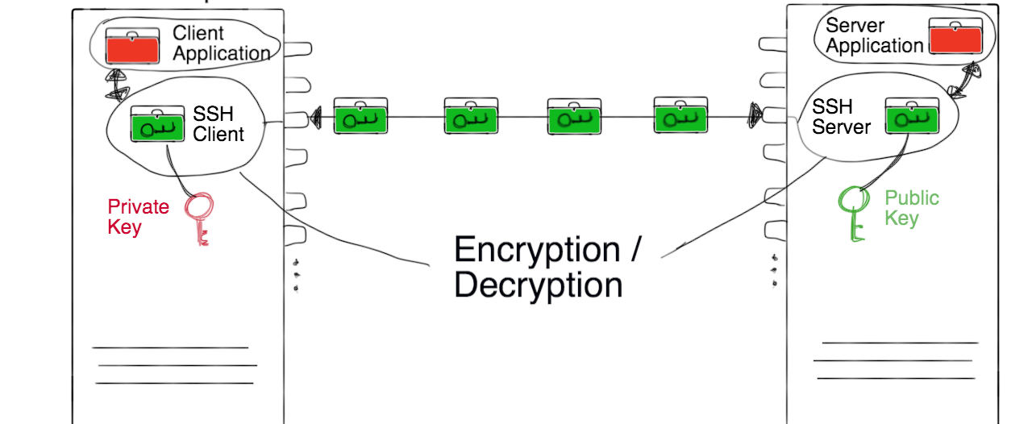
SSH (“Secure shell”)

Slide 10
Creating a SSH key
Exercise 1:
We will have to generate this key pair before we can proceed with launching an instance.
Depending on your Operating system, follow the instructions given in the On-Line Documentation.
Notes:
Do a demo for the exercise.
Put up the next slide as a reference while people are doing the exercise.

Slide 11
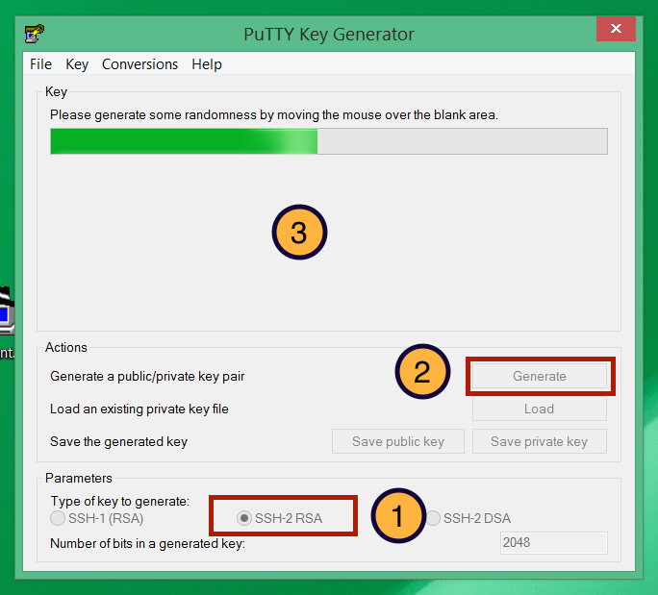
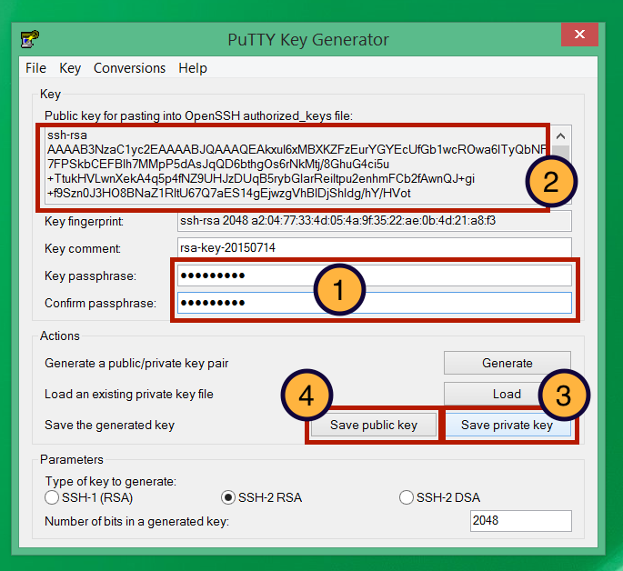
Creating a SSH Key
Mac and Linux summary:
Open a Terminal and change to home. $ cd
If you don’t have a .ssh directory: $ mkdir .ssh
$ cd .ssh $ ssh-keygen -t rsa –f Nectar_Key
Copy the content of Nectar_Key.pub onto the clipboard, e.g. on Mac:
$ open -e Nectar_Key.pub
Windows summary:
Open PuTTYgen.exe

Slide 12
Launching an instance

Slide 13
Launching an Instance
We will now launch an instance.
Before we start, a note about “Security Groups”:
We will need to free up ports in the firewall so that we can connect to the instance (see also Module 5).
The Firewall is configured with “Security Groups”—essentially a collection of firewall rules.
The Trial Account comes with some pre-configured security groups which we will use.
Notes:
You can also set up your own security groups, the On-line Documentation includes instructions.

Slide 14
Launching an Instance
Exercise 2:
Open the browser of your choice and go to the Dashboard:
https://dashboard.rc.nectar.org.au/
We will do a quick Demonstration now—find detailed instructions in the On-Line Documentation.

Slide 15
Congratulations!
You have successfully launched your first instance.
Don’t forget to write down the IP address before we continue!
In the following instructions, your IP address will be represented by “NNN.NNN.NNN.NNN”.
You can look up your IP any time on the Dashboard:
Compute → Instances

Slide 16
Connecting with a terminal

Slide 17
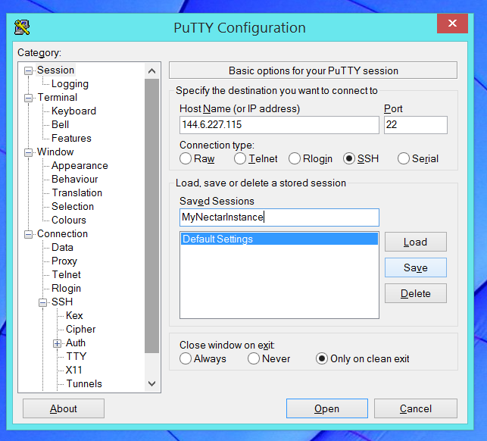
Connect to the Instance
Exercise 3:
1. Test Connectivity: Open a local terminal and check if you can reach it:
$ ping NNN.NNN.NNN.NNN
2.Connect to the instance:
Linux/Mac:
$ssh -i Nectar_Key ubuntu@NNN.NNN.NNN.NNN
You may need to specify the key: $ ssh -i ~/.ssh/Nectar_Key ubuntu@NNN.NNN.NNN.NNN
Windows:
Configure PuTTY: Follow instructions in the On-Line Documentation

Slide 18
Connect to the Instance
Well done!
Welcome to your new virtual machine.
You are now connected to the instance and we can start typing commands into the terminal.
Notes:
We will start with some first configurations which are recommended for setting up a new instance.

Slide 19
Configuration and Control
Exercise 4:
Use your ssh terminal to type the commands.
1. Make sure your system is updated:
$ sudo apt-get update $ sudo apt-get dist-upgrade
2. Change the passwords for ubuntu and root:
$ passwd $ passwd root

Slide 20
Configuration and Control
Exercise 5:
Edit a file in the command line editor.
You may use the editor nano to open a file: $ nano <path-to-your-filename>
1. Create a file and write content into it: $ nano MyFile.txt
2. Close and save with [Ctrl+X].
3. Print contents of the text file on the screen: $ cat MyFile.txt

Slide 21
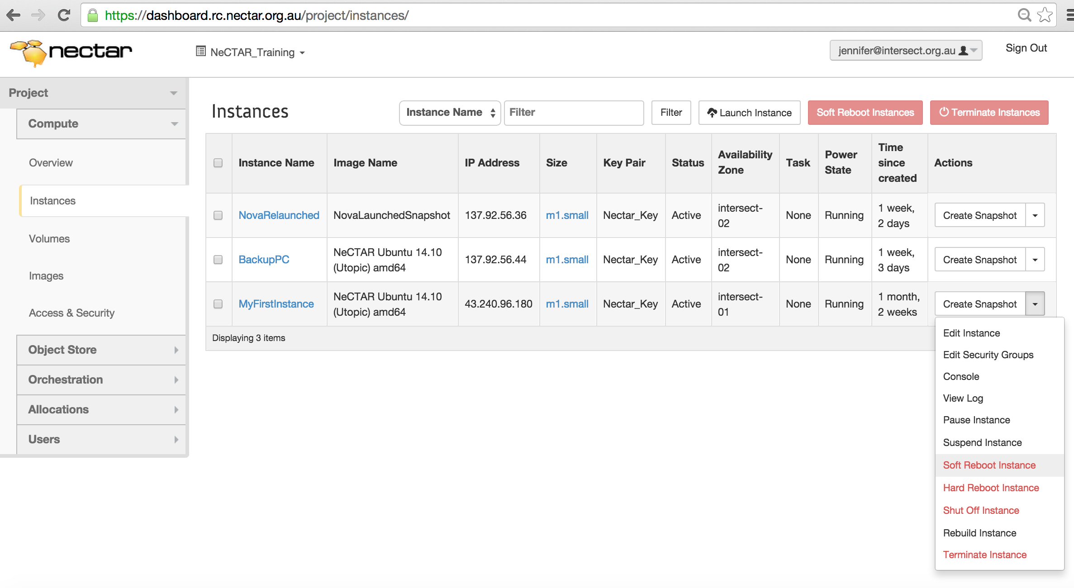
Configuration and Control
Exercise 6:
Reboot your instance and re-connect to it after reboot.

Slide 22
Connect to a remote desktop

Slide 23
Connect to remote desktop
A remote desktop login allows users to connect to their desktop while being physically away from their computer.
You will need to install two things:
Your instance has to run a remote desktop server.
On your local computer, you have to install a remote desktop client (a “viewer”) which will show the desktop.
Notes:
As an alternative to connecting with a ssh terminal, we can also connect to the desktop of our instance

Slide 24
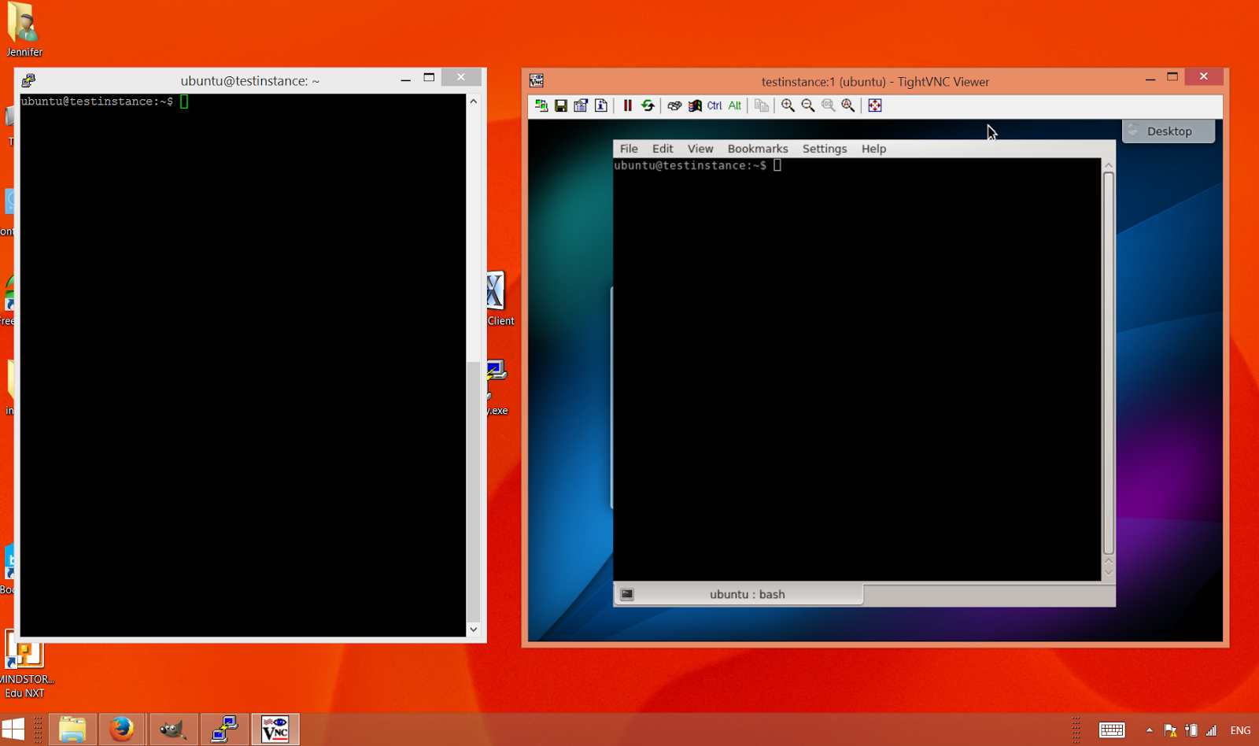
Connect to remote desktop
Terminal on remote desktop vs. SSH terminal
Notes:
Explain how the using either of the two terminals have the same effect – essentially, our ssh terminal is like an open terminal on a remote desktop.

Slide 25
Connect to remote desktop
The communication with remote desktops is supported by a protocol.
There are a number of protocols described in the On-Line Documentation.
We will use two of them to connect to the remote desktop, along with the tools which support them:
The NX protocol used by the X2Go tool.
The VNC protocol used by VNC servers & viewers.

Slide 26
Connect to remote desktop
VNC
X2Go (NX protocol)
inherent support of different platforms
is widely used → large number of tools
is slow
is inherently insecure, requires ssh tunneling.
is fast
there are not many well-maintained servers and clients available (X2Go is one of the few)
Servers can only be installed on Unix servers, for Windows/Mac there are only clients
On a Mac, it requires extra tools and can be a little slower.

Slide 27
Connect to remote desktop
Desktop environments for Linux systems:
Gnome / Unity,
KDE,
LXDE,
XFCE,
Mate,
and more.
We will use the simple light-weight LXDE in this tutorial.

Slide 28
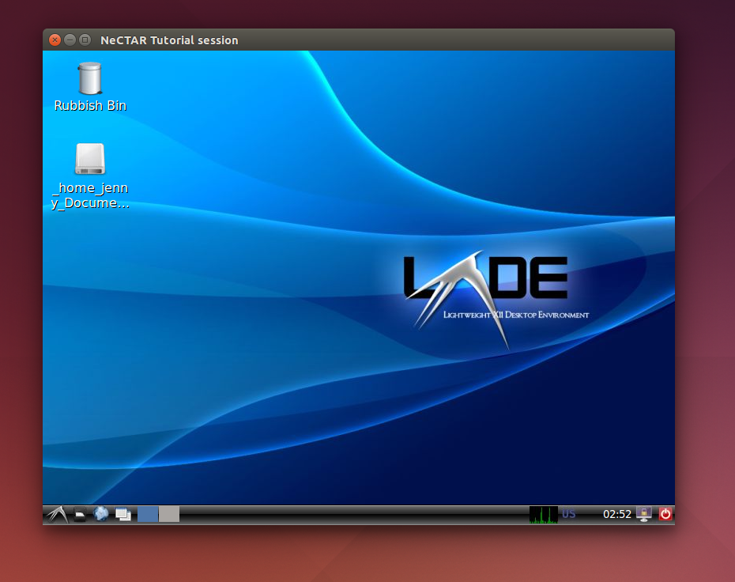
Connect to remote desktop
Exercise 7:
Install the desktop environment LXDE.
In your ssh terminal:
$ sudo apt-get install lxde

Slide 29
Connect to remote desktop with X2Go
Exercise 8: Connect with X2Go.
Step 1. Install the x2go server and bindings for LXDE. In your ssh terminal: $ sudo add-apt-repository ppa:x2go/stable $ sudo apt-get update $ sudo apt-get install x2goserver x2goserver-xsession $ sudo apt-get install x2golxdebindings Step 2. Install the x2Go client on your local computer:
Windows: Download from the x2Go website (google “x2go”) and install.
Linux:
In your local terminal: Add repository (first 2 commands above). Then:
$ apt-get install x2goclient
Mac:
Follow instructions in On-Line Documentation.

Slide 30
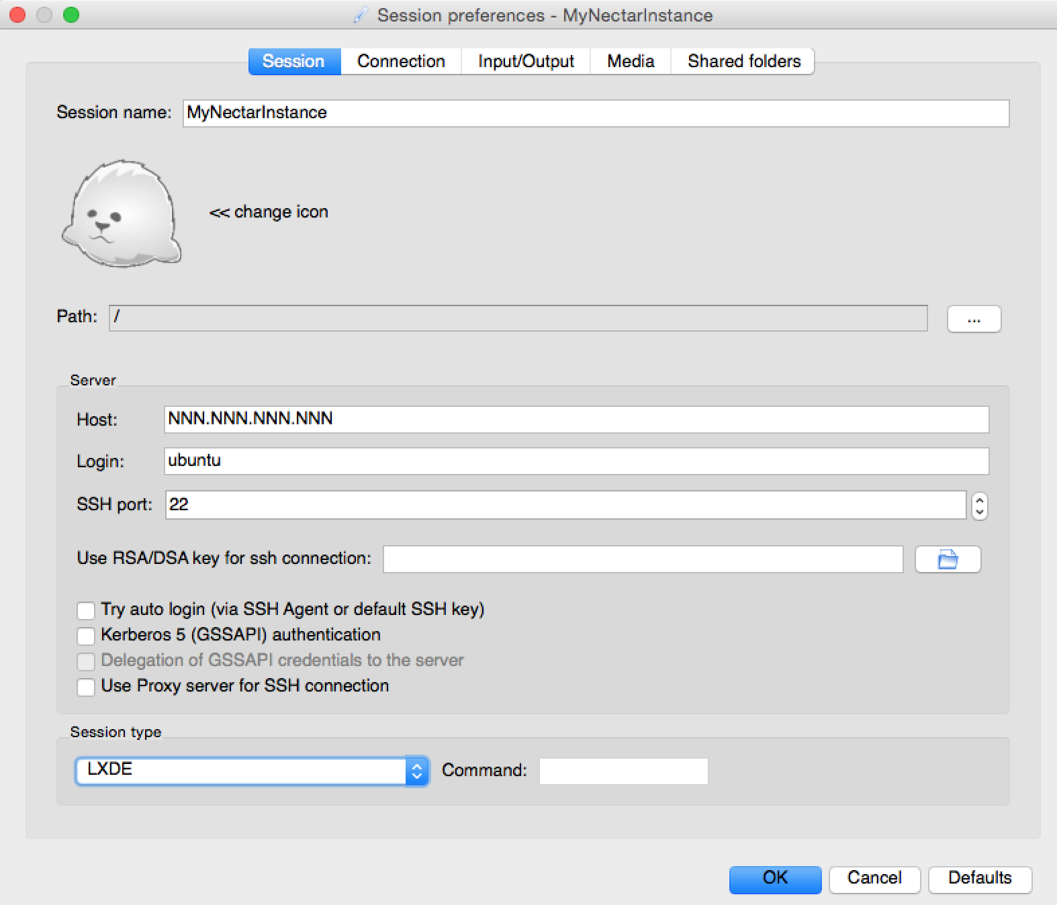
Connect to remote desktop with X2Go
Exercise 9: Connect with the X2Go client.
Start the client application and configure your session.
Click “OK” and double-click on your session box to connect.

Slide 31
Connect to remote desktop with X2Go
Congratulations!!
You are now connected to your remote LXDE desktop with the X2Go client.

Slide 32
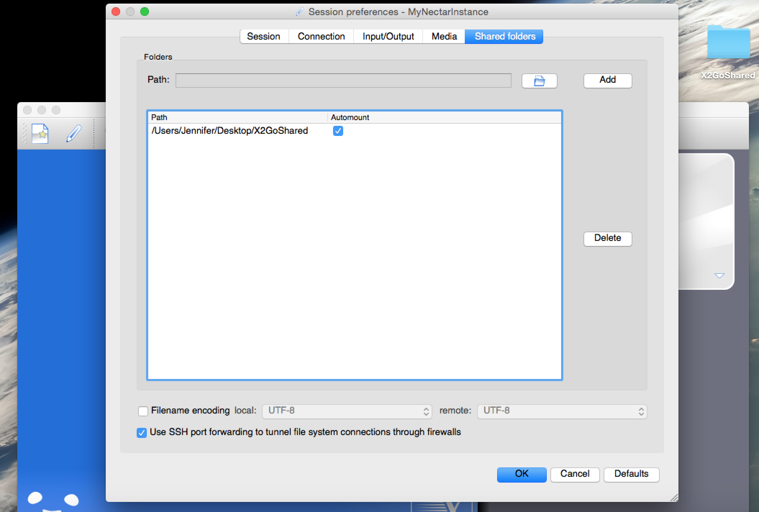
Connect to remote desktop with X2Go
Exercise 9: Set up file sharing with X2Go.
Step 1. In your ssh terminal: $ sudo adduser ubuntu fuse
Step 2. Create a folder called X2GoShared on your desktop.
Step 3. Configure your x2go clients session preferences (see image):
Go to Shared Folders and Select folder.
Then, “Add” and check “Automount”.

Slide 33
Connect to remote desktop with X2Go
Exercise 10:
Share files between your local computer and your instance.
Log back on with the x2go client.
Our shared folder will appear on the remote LXDE desktop.
Create a plain text file named MyTestFile.txt and save it in the X2GoShared folder on your local desktop. Close the file.
Go to your remote desktop, open the file in the shared folder, edit it.
Go back to your local computer, open the file again and see that the changes have been applied.

Slide 34
Connect to remote desktop with VNC

Slide 35
Connect to remote desktop with VNC
Exercise 11: Install and configure the VNC Server.
$ sudo apt-get install vnc4server $ vncserver (Choose a password) $ vncserver -kill :1 $ nano .vnc/xstartup
“Comment” lines:
# x-terminal-emulator –geometry […] & # x-window-manager&
Add the lines:
lxterminal & /usr/bin/lxsession -s LXDE & vncserver -geometry 1024x768 -depth 24

Slide 36
Connect to remote desktop with VNC
Exercise 12:
Connect to the remote desktop.
1. Set up ssh tunneling
2. Install VNC Client on your local computer
3. Connect to the VNC remote desktop
Notes:
We will do a demonstration, after which you can follow detailed instructions in the
On-Line documentation, which also provides extra information on how to auto-start the VNC Server.

Slide 37
Connect to remote desktop with VNC
Hurray!
You are now connected to your remote desktop using VNC.
You can use VNC and X2Go interchangeably according to your preference.
Info: You may also run several desktop environments (see documentation).

Slide 38
Graphical applications on SSH terminal

Slide 39
Graphical applications on SSH Terminal
You can run graphical applications via the command line terminal as well.
Advantage: No need to install remote desktop.
Disadvantages:
Poses a new security threat for your graphical desktop on your local computer.
Is very slow

Slide 40
Graphical applications on SSH Terminal
Exercise 13:
Let’s try it out! In the ssh terminal, enable X11 forwarding:
$ sudo nano /etc/ssh/sshd_config (line: X11Forwarding yes) $ sudo /etc/init.d/ssh restart (if you had to edit the file) $ logout
Windows:
- Install Xming. - Change Putty Session Prefs. Connection → SSH → X11: 1. Check “Enable X11 Forwarding”. 2. Display location: “localhost:0”. 3. Save session and reconnect
Linux/Mac:
Mac: Install XQuartz if you haven’t already for X2Go.
$ ssh -i <your-private-key-file> -X ubuntu@NNN.NNN.NNN.NNN

Slide 41
Graphical applications on SSH Terminal
Exercise 13 (continued):
Now, run a graphical application in your ssh terminal:
xcalc & sudo apt-get install firefox firefox &

Slide 42
Installing a web server
Notes:
Your instance is already connected to the Internet—it is very easy to publish your first Website!

Slide 43
Install a Web Server
Exercise 14:
1. In your ssh terminal, install the web server Apache:
$ sudo apt-get install apache2
2. Open a browser and type your instances IP address into the URL field. There’s the test page!
3. You can change the test page in your ssh terminal:
$ nano /var/www/html/index.html
Notes:
In demo, change the test file just to display another welcome message, and say that from here on people will need either HTML knowledge or use other tools to generate HTML.
The apache browser can also be pointed to load other pages (not /var/www/html/index.html) by default.

Slide 44
Managing storage

Slide 45
Managing storage
We will now go through the steps required to
Set up various types of storage on our instance.
Transfer data from and to your cloud storage and your local computer.

Slide 46
Managing Storage
Brief storage recap:
Object storage: Access to single files via a simple web interface or client application.
Volume Storage and On-Instance (Ephemeral) Storage are directly attached to your instance.
Ephemeral storage is tightly attached to your instance and is deleted when you terminate (delete) it.
Volume Storage can be attached and detached from your instance(s). Terminating the instance does not affect the data.

Slide 47
Managing storage
The NeCTAR trial account only includes Object Storage and Ephemeral Storage.
You will have to file an allocation request to get access to Volume storage.
If you are using the Trial Account:
Exercises for On-Instance storage already cover most configuration steps required for Volume Storage.
Notes:
If you are using the Trial Account:
You can still do exercises for Object and On-Instance Storage.
Exercises for On-Instance storage already cover most configuration steps required for Volume Storage.
Watch the Demonstration of the Volume Storage exercise. It will be easy to understand after we have covered On-Instance storage.

Slide 48
Accessing On-Instance storage

Slide 49
On-Instance Storage
On-Instance Storage appears as two hard disks:
Primary disk, used for OS and home directory.
Secondary disk: intended for data storage.
In the flavor “m1.small” the disks are 10GB (primary) and 30GB (secondary).
To get access to the secondary disk, we will have to “mount” it first.

Slide 50
On-Instance Storage
Mounting is a technique which essentially makes your hard drive accessible to you at a certain location (in a folder).
Usually, the secondary disk is available on your device path “/dev/vdb”—files and folders are not directly accessible there.
We have to “mount” /dev/vdb to a folder on our instance.
On the Ubuntu Image used in this tutorial, /dev/vdb is auto-mounted on the folder /mnt.
We will undo this and do all steps required to set up the disk.
Notes:
This is a device path, so you cannot list and access files as if it was a folder.

Slide 51
On-Instance Storage
Exercise 15:
Prep: Check mountpoint and size of the disk. Unmount the disk.
$ sudo lsblk –l
$ sudo umount /mnt
Step 1: Format your drive. List the filesystem of your drive and change it to ext4:
$ sudo lsblk –f
$ sudo mkfs.ext4 /dev/vdb
Step 2: Mount the drive in a folder /data and list the contents:
$ sudo mkdir /data
$ sudo mount /dev/vdb /data
$ ls /data

Slide 52
On-Instance Storage
Exercise 15 (continued):
Step 3: Add write permissions.
Try to create and edit a new text file. You cannot save it!
$ nano /data/newFile.txt
Change the owner of the disk mounted on /data to your user ubuntu. Then, try to create the text file again.
$ sudo chown ubuntu /data
Step 4 (optional): Configure auto mounting.
$ sudo nano /etc/fstab
Change /mnt to /data or add this line:
/dev/vdb /data auto defaults,nobootwait 0 2

Slide 53
Accessing Object Storage

Slide 54
Object Storage
You can connect to your object store with a variety of clients, as long as they support OpenStack Swift or Amazon S3.
We will access the Object Store via the Dashboard.
The On-Line Documentation offers instructions for accessing the Object Store using other clients .
Notes:
Encourage students do explore other clients in their own time: the other clients offer very convenient access.
Maybe show them working examples of Cyberduck and an FTP client. Advanced users will also love to know about CloudFuse. It’s all described in the On-Line documentation, so they can read through the stuff right now.
Maybe allocate extra time after the next exercise (Dashboard access to the Object Store), so the can play around with other tools.
Security Warning
Swift does NOT provide encryption of the data it stores.
If you have sensitive data that requires encryption, you must encrypt the data files before upload them to your object store.

Slide 55
Object Storage
Exercise 16: Access the Object Store via the Dashboard.
Follow instructions in the On-Line Documentation.
Prep: Create a text file “SampleObject.txt”, write some text into it, and save it on your Desktop.
Step 1: Create a container named “MyObjectContainer”.
Dashboard → Object Store → Containers: Create container
Step 2: Upload a file.
Click [Upload Object] on right-hand side of your container.
Upload SampleObject.txt.

Slide 56
Accessing Volume Storage

Slide 57
Volume Storage
Access Volume storage from your instance.
Create a Volume.
Attach the Volume to the instance.
Prepare the Volume for use within your instance.
Notes:
For people who cannot do the exercise:
Watch the demonstration.
Then, they may find time to explore more Object Store clients while the others complete the exercises.

Slide 58
Volume Storage
Exercise 17: Create and access a Volume.
Follow instructions in the On-Line Documentation.
Step 1: Create a Volume in your availability zone.
Step 2: Attach the Volume to your instance.
Step 3: Preparing your Volume for use.
Format and mount the Volume.
Same steps as for On-Instance Storage!
Notes:
Do complete deomonstration of exercise before you let them start with it—then people who can’t access volumes may do a break or play with object store clients.
If nobody in the class has access to Volume store, leave it at this demonstration and then continue with the slides.

Slide 59
Copying files across

Slide 60
Copying files across
How to access files on your ephemeral or volume storage from your local office computer. Either
Using a SFTP client, or
On the command line, using a secure copy command.
In this course, we will only do Option 1. The On-Line Documentation provides instructions on how to use the command line.

Slide 61
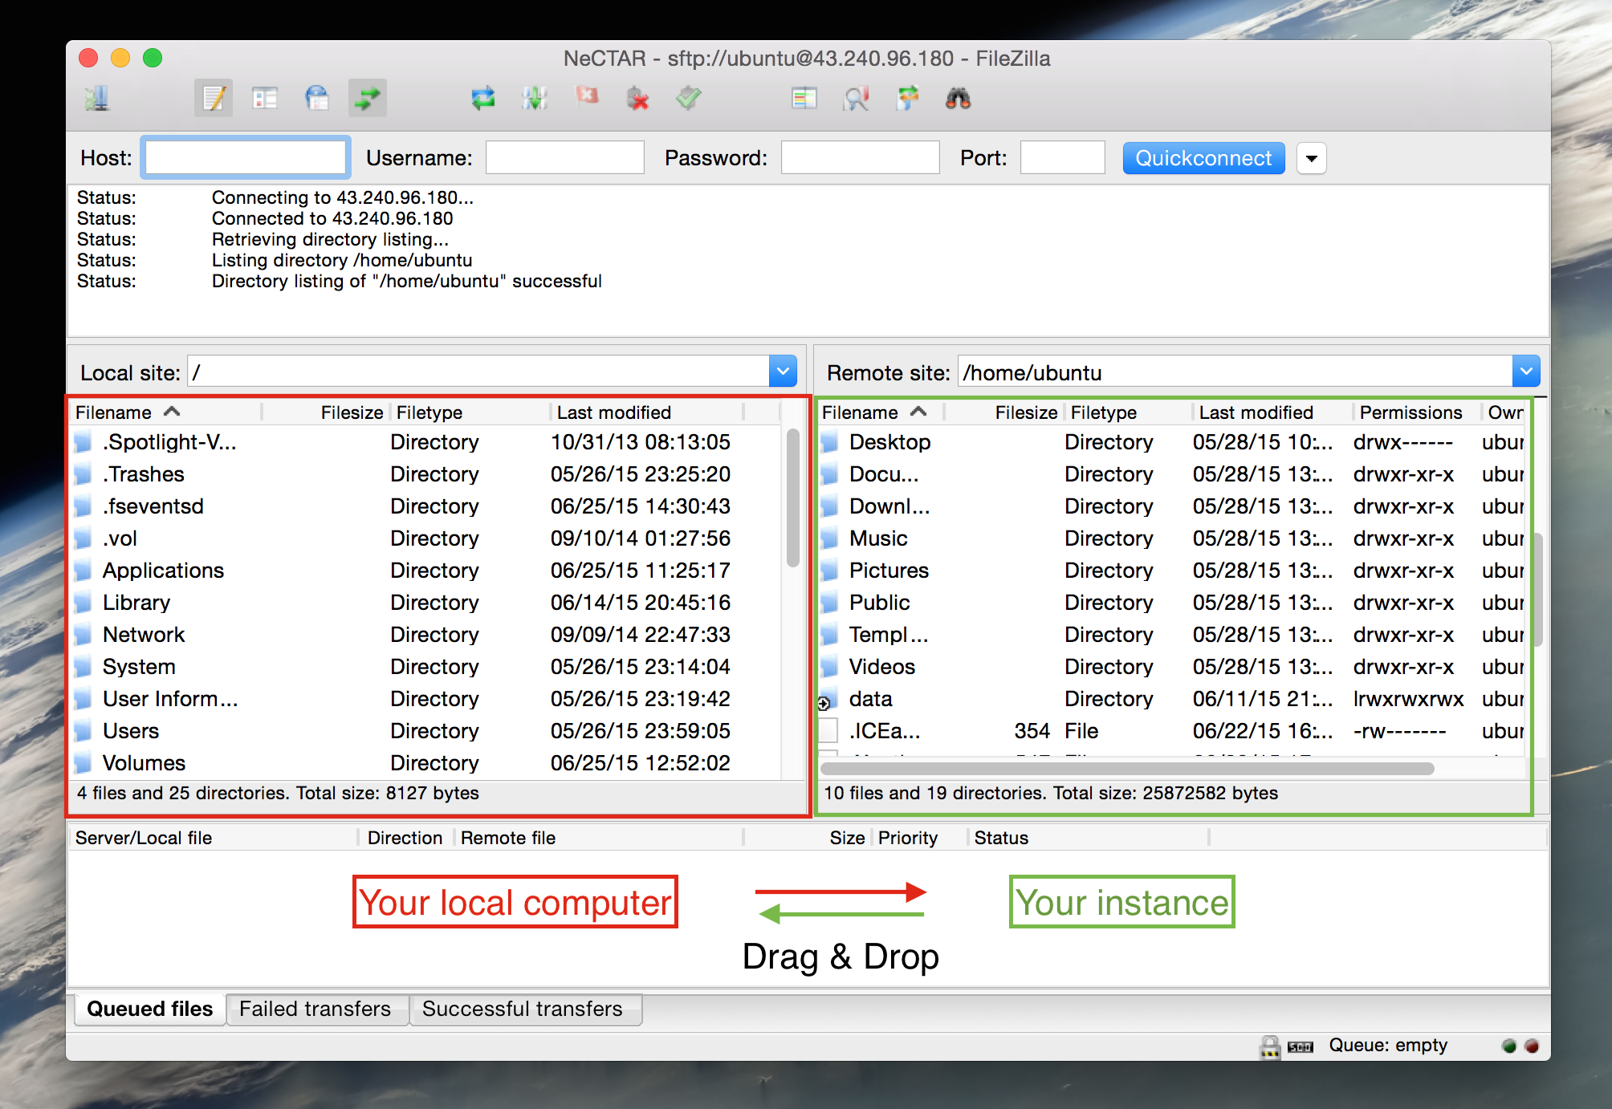
Copying files across
Result of the next exercise: Drag & Drop files across
Notes:
Explain to them that this is the outcome of the next exercise: we will be able to drag & drop files across

Slide 62
Copying files across
Exercise 18:
Install and use the FileZilla FTP client to transfer files between your local computer and your instance.
Step 1: Install FileZilla.
Step 2: Enable your SSH Agent
Windows: Download, install & configure the PuTTY tool Pageant.
Linux / Mac OSX: In a local terminal:
$ ssh-add ~/.ssh/Nectar_Key
Step 3: Configure your site in FileZilla
File → Site Manager
Host: Your IP; Port: 22; Protocol: SFTP; Logon type: Normal; User: ubuntu; password: The password for ubuntu user.

Slide 63
Closing note
Well done!!
You now know the most important practical steps for creating and managing your NeCTAR Research Cloud resources.
More hands-on experience in the next Modules:
Module 8: Encrypting data (files and entire disks).
Module 9: Backing up your resources, cleaning up your disks.
Module 10: Do everything from previous modules using the command line only!

